Slide 1
SUMMIT ELEMENTARY
Traffic Improvement

Slide 2
PROJECT GOAL
Improve safety and traffic flow around Summit Elementary during student arrival and dismissal
TIMELINE
May 11-29: Deploy pilot
August 3: Install traffic improvements

Slide 3
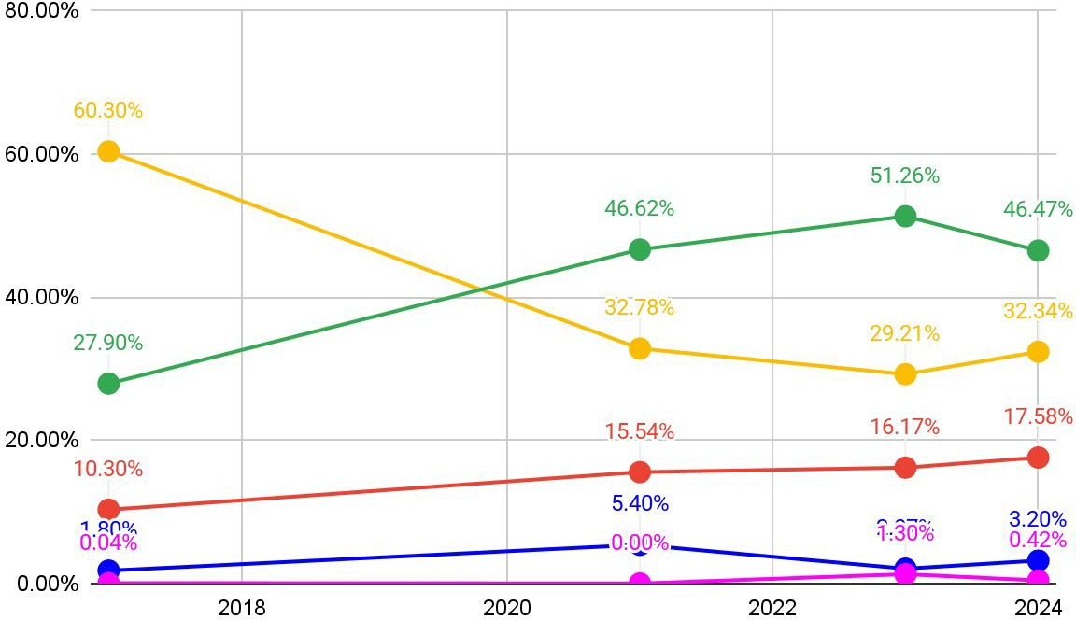

STUDENT TRAVEL DATA
BUS
CAR
WALK
BIKE TRANSIT

Slide 4
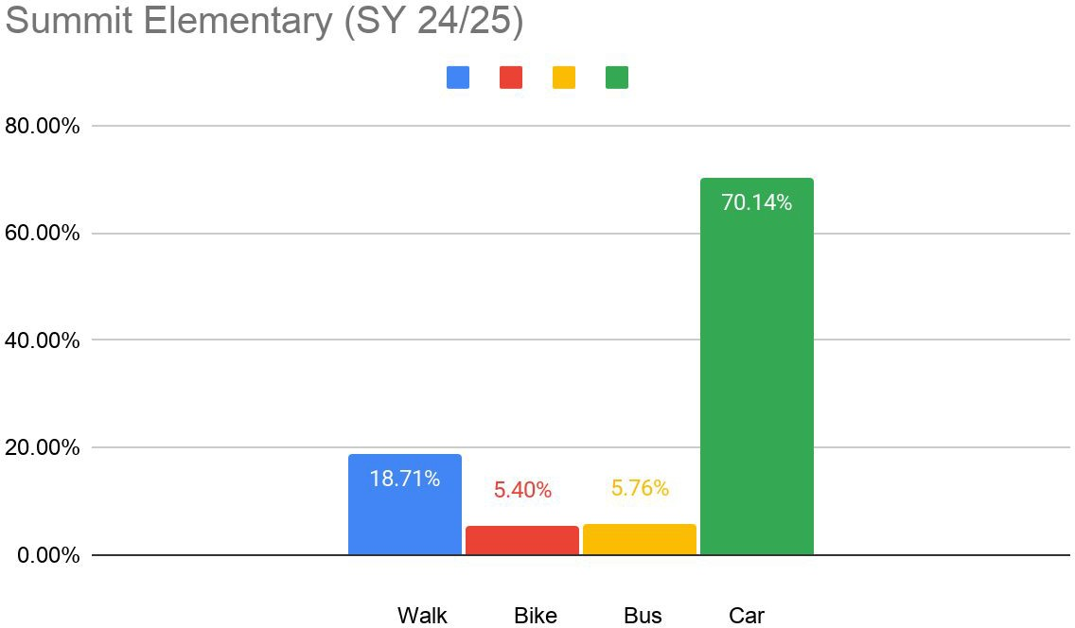

Slide 5
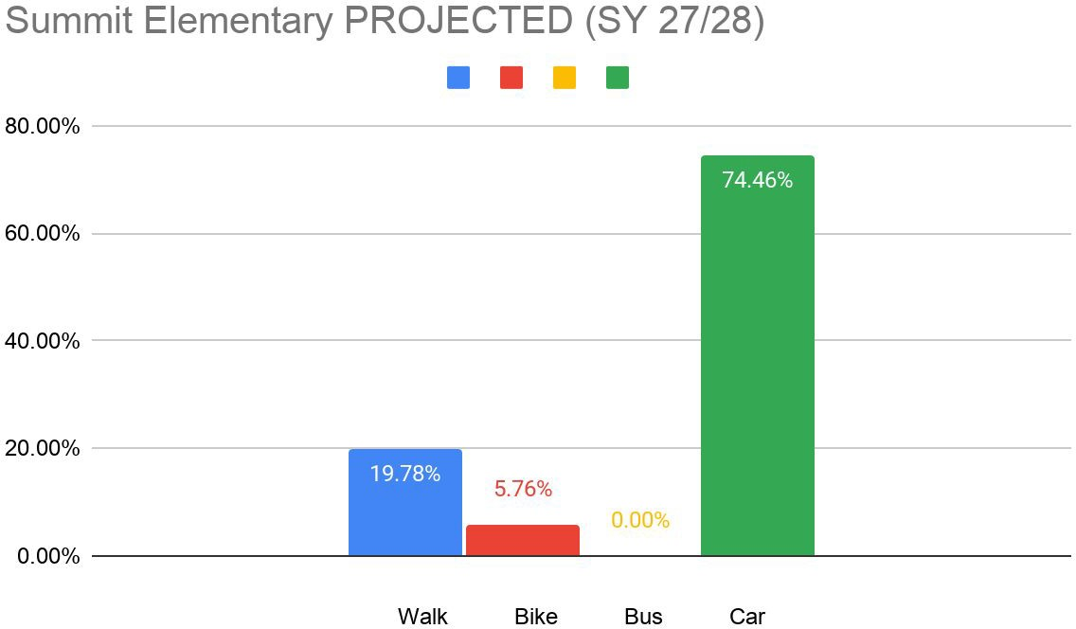

Slide 6
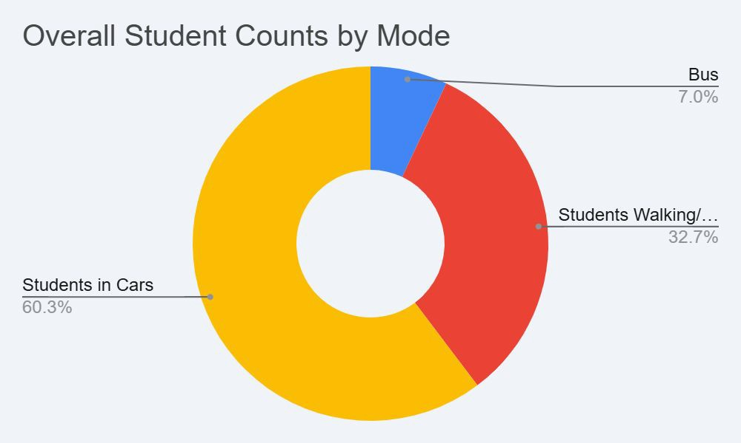
BELMONT AVENUE TRAFFIC COUNTS
Date | Cars | Kids in Cars | Kids Walk/Ride | Bus Riders
4/3/26 | 50 | 84 | 26 | 9
4/13/26 | 42 | 72 | 41 | 9
4/14/26 | 50 | 76 | 59 | 9

Slide 7
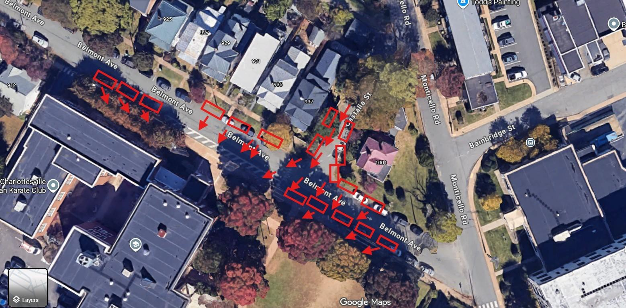
WHERE CARS ARE STOPPING

Slide 8
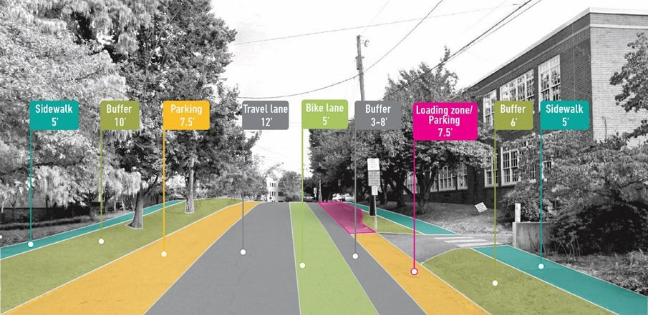
BELMONT AVENUE CURRENTLY

Slide 9
SOLUTION PILOT
Vehicle Drop-Off on Belmont
Create a car drop-off lane on Belmont Avenue allowing families to drop their students off on that side of the school.
Keep vehicle traffic more organized and predictable
Eliminate students from crossing lanes of traffic
Create an official place for vehicle drop-off to occur
Add a three-way stop at Belmont Avenue and Meridian Street
Bus drop-off on Tufton Avenue
Can still drop off on Monticello Avenue
Pilot will run from May 11-29

Slide 10
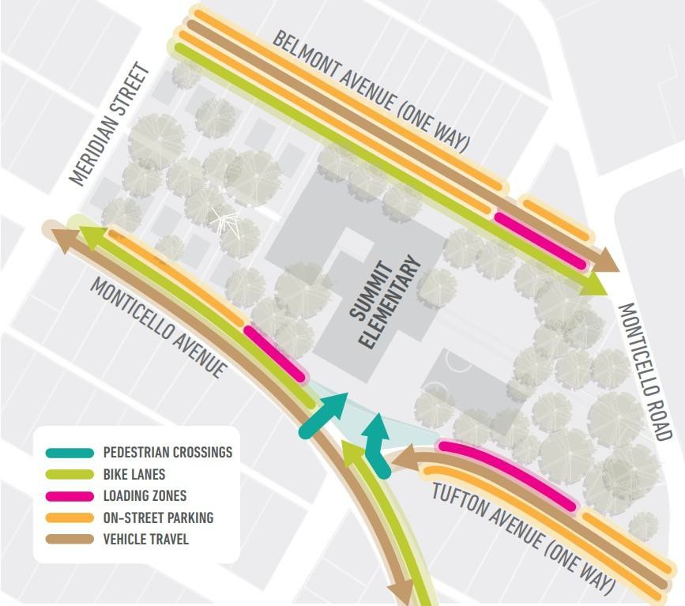

Vehicle Drop-Off on Belmont Design
Dedicated personal vehicle loading lane on Belmont Avenue, next to the travel lane
Bus loading/parking on Tufton Avenue
Dedicated personal vehicle zone lane on Monticello Avenue
Bike lane will end at school driveway

Slide 11
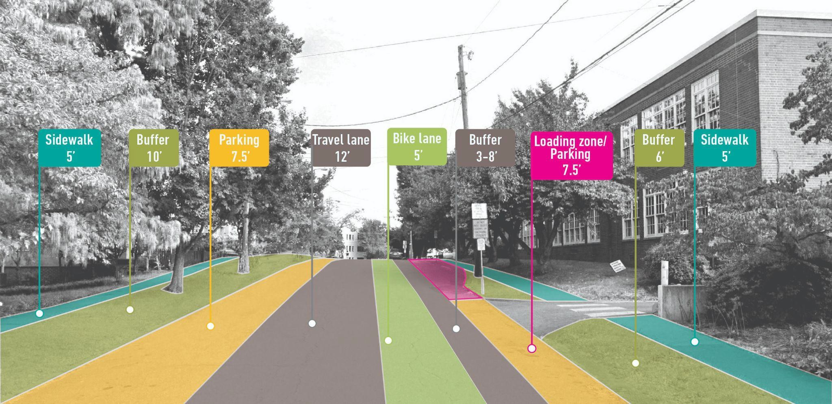

DROP-OFF LANE EXAMPLE

Slide 12
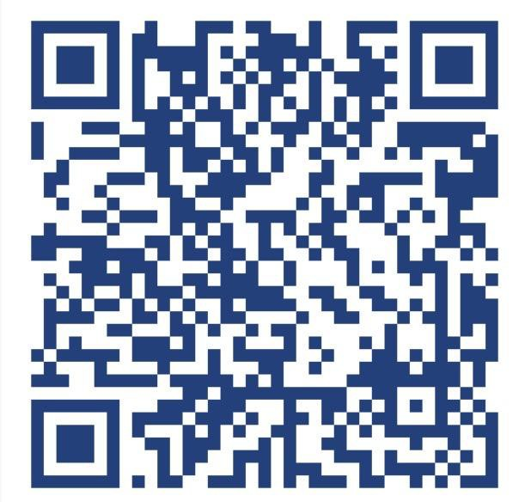
STAY UP TO DATE ON THIS PROJECT AND SUBMIT FEEDBACK
Staff Contact:
Kyle Rodland
Safe Routes to School Coordinator
rodlandk@charlottesville.gov

