Slide 1
Fifeville Traffic Calming
August 13th, 2026

Slide 2
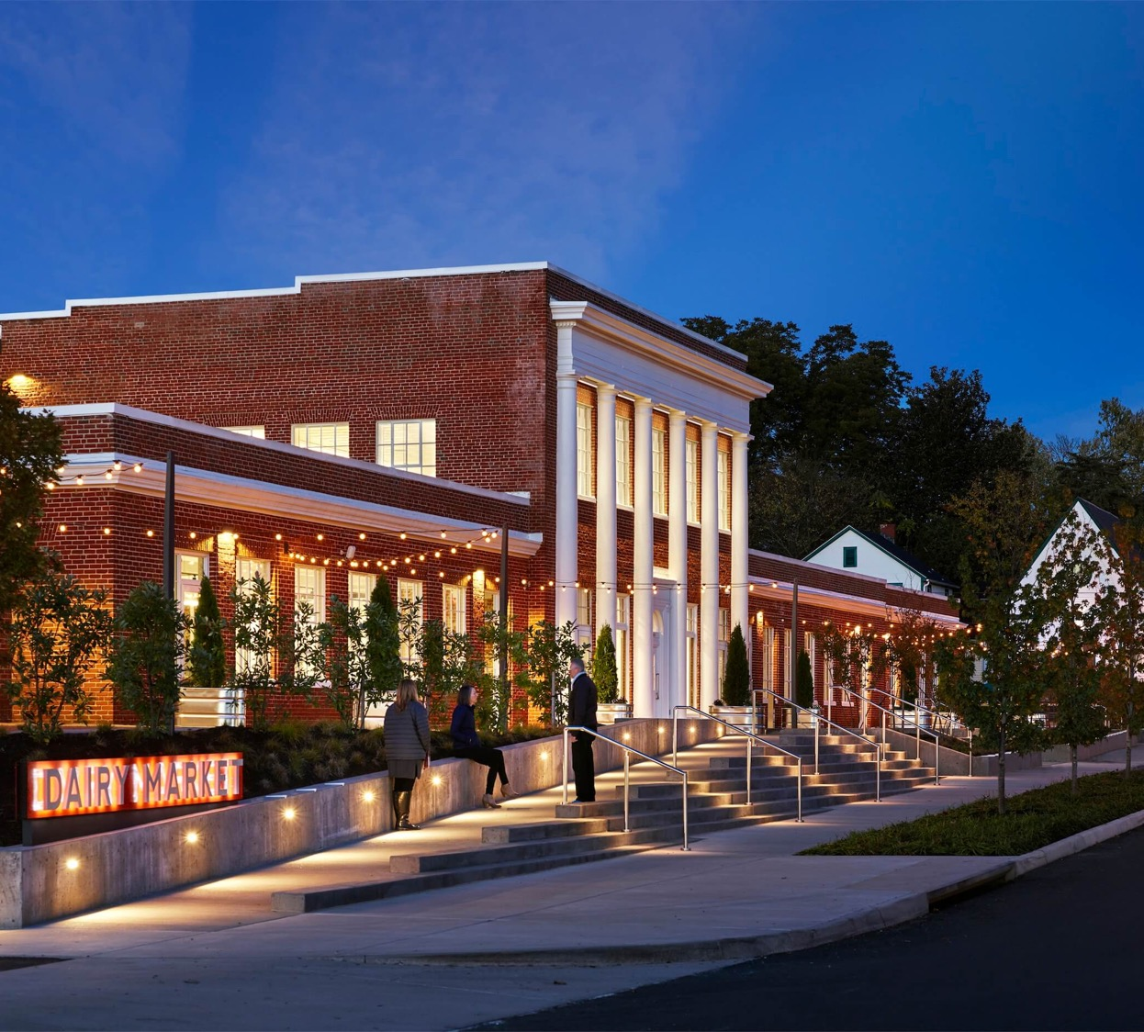
Agenda
Welcome and acknowledgements
Ground Rules
Review of previous meeting results
Existing Conditions
Small Group Exercise and Alternatives
Next Steps

Slide 3
GOAL
Improve travel conditions in the Fifeville Community
OBJECTIVES
Create calmer neighborhood streets.
Create safer neighborhood streets.
Create more comfortable neighborhood streets.

Slide 4
GROUND RULES
One topic at a time.
Listen twice.
Offer suggestions and recommendations that will help improve travel conditions.
Ask specific questions related to the topic and pilot program.

Slide 5
GROUND RULES
Exhibit mutual respect.
Provide equal opportunity for everyone to speak and contribute.
Appreciate the opportunity to listen, learn, participate, and contribute.
Appreciate the time together.

Slide 6
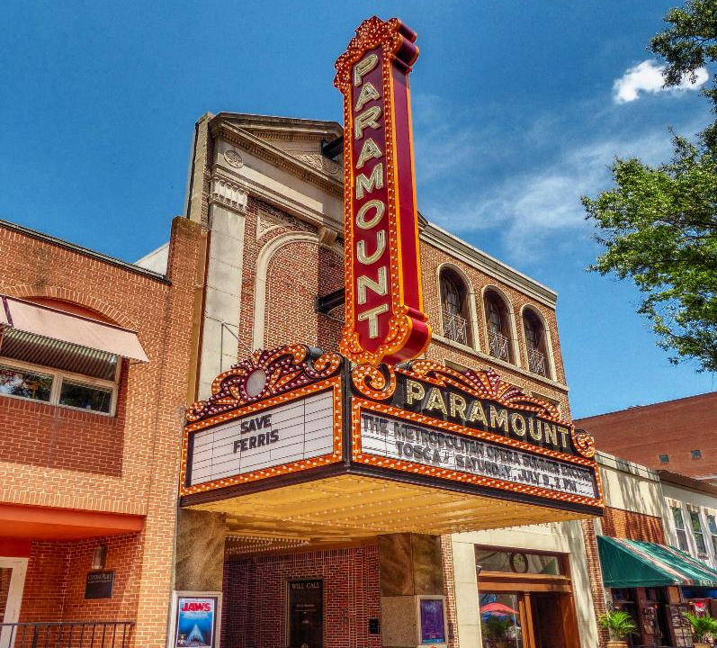
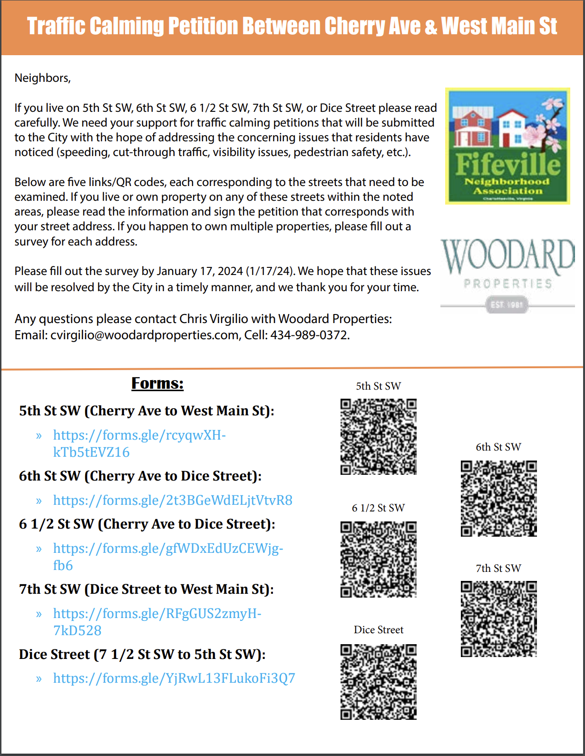
How did we get here?
501 Cherry Development Plan
Neighborhood worried about additional traffic impacts
Woodard Properties partnered with the community to put together Traffic Calming Petition
March 14th Meeting with “Block Captains” to clarify where the pain points were located.

Slide 7

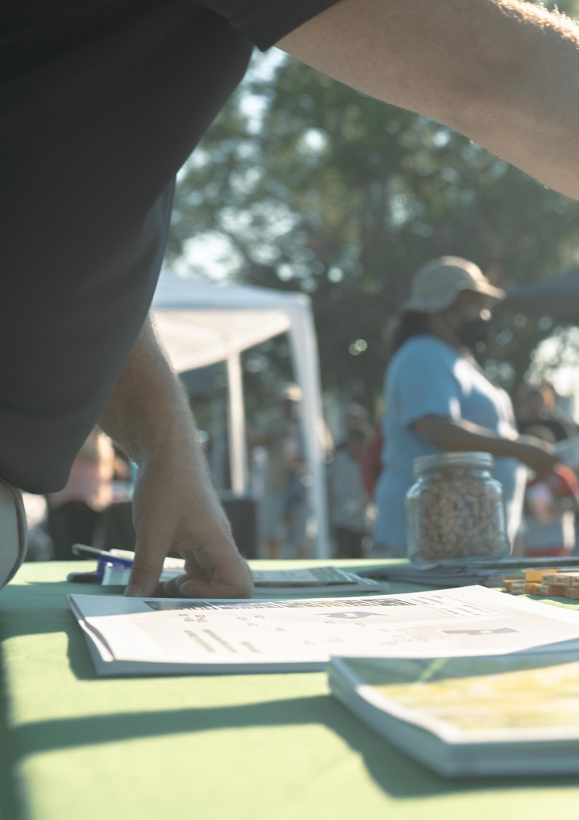
What we heard from the “Block Leaders(2024)”:
“Reduce cut-thru Traffic”
“Dangerous intersections/roads with sight distance”
“Cars going the wrong way”

Slide 8
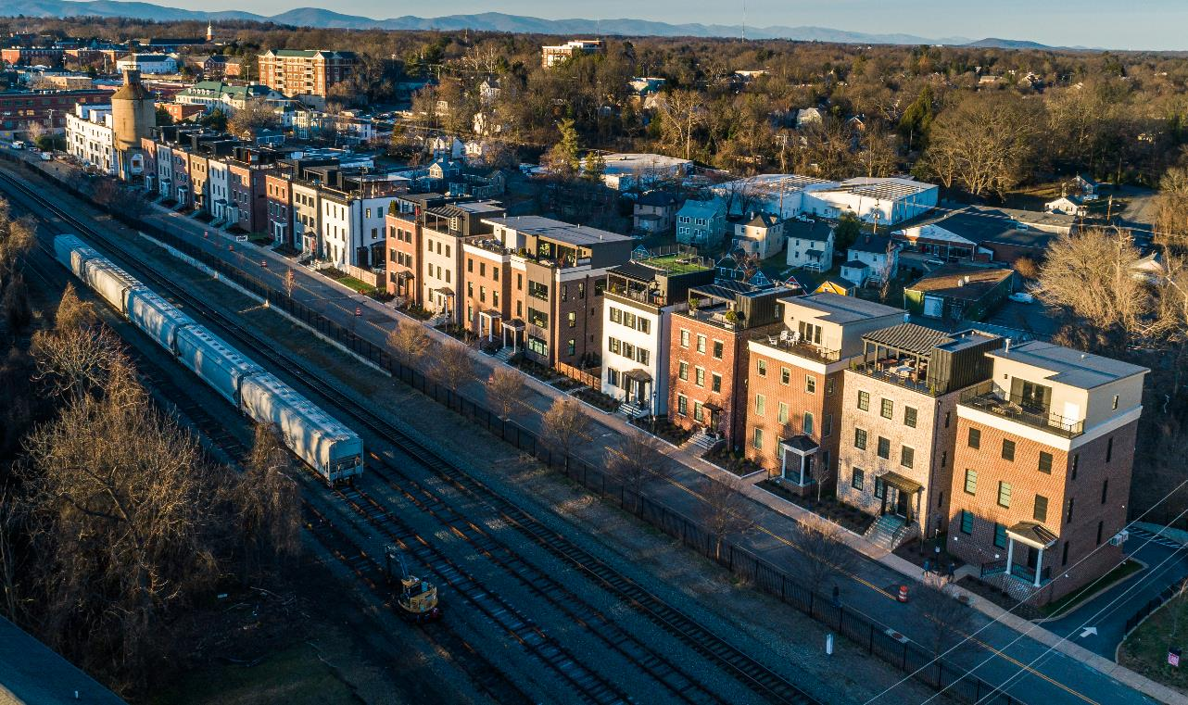
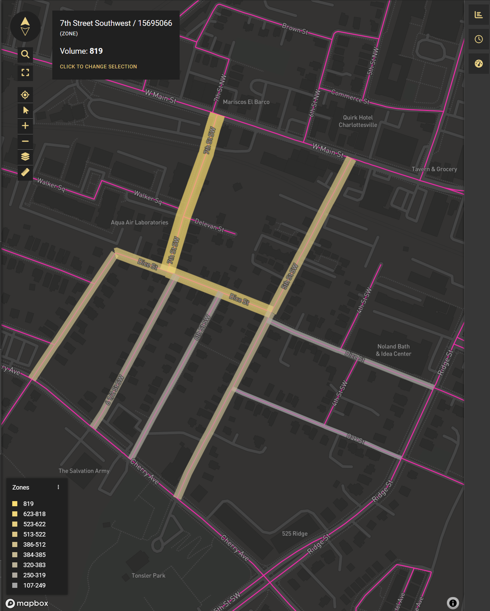
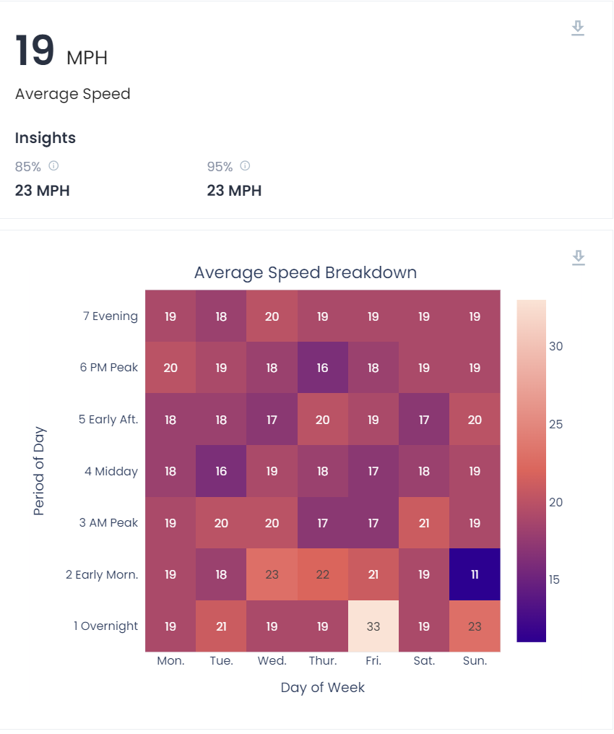
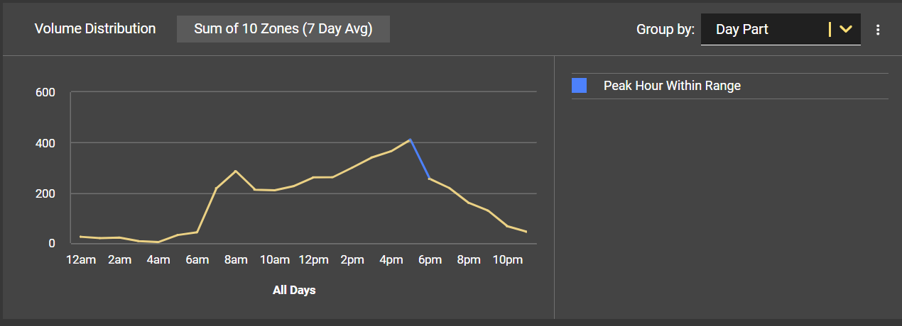
Studies

Slide 9
Results
TOTAL NUMBER OF VEHICLES PER DAY: ~4200
CUT-THRU VEHICLES PER DAY(W.MAIN TO CHERRY):~300
CUT-THRU VEHICLES PER DAY(CHERRY TO W.MAIN):~300
85TH PERCENTILE SPEEDS ~28 MPH
~5% IN EXCESS OF 45 MPH

Slide 10
Results
CUT-THRU VEHICLES PER DAY(W.MAIN TO CHERRY):~300
CUT-THRU VEHICLES PER DAY(CHERRY TO W.MAIN):~300
85TH PERCENTILE SPEEDS <25MPH
HANDFUL OF DRIVERS DRIVING WELL IN EXCESS OF LIMIT

Slide 11

Methodology
We evaluated the data against the city’s current traffic calming policy. We also used this as an opportunity to test some components of the updated traffic calming policy which is still in draft form.
Existing Policy –
10+ mph over 85th percentile to qualify for speed-related intervention
800+ vehicles per day for volume-related management
Cut-through traffic >30%
History of preventable crashes (last 3 years)
Under current policy (2008) neighborhood streets with 800 VPD qualify. This volume exists largely due to cut-through traffic on select streets.

Slide 12
Updated Policy (Draft)
The updated scoring rubric takes a more nuanced look at the composition of the facilities being studied by considering factors beyond traffic speeds and volumes. Although not yet formally adopted, we opted to include aspects of the draft policy as an evaluative supplement.
- Lower threshold for speed-related intervention (5mph over 85th percentile instead of 10mph)
- Looks at proximity of pedestrian generators (parks, schools, churches, etc.)
- Considers housing density
- Evaluates physical characteristics of the street / sidewalk network
- Provides a pedestrian safety risk estimate

Slide 13
Updated Scoring Rubric
Criteria | Point Definitions | Points Available | Nalle St. | King St. | Oak St. | 300 Blk Dice St. | 600 Blk Dice St. | 200 Blk 5th St. | 400 Blk 5th St. | 6th St. | 6-1/2 St. | 7th St. | 7-1/2 St.
85th Percentile Speed | 3 Points for every 1 mph the 85th percentile speed exceeds the posted speed limit (85th percentile must be at least 5 mph over the posted speed to be considered for speed-related traffic calming) | 30 | 9 | 0 | 0 | 8 | 0 | 0 | 0 | 0 | 0 | 6 | 9
Crash History | 5 Points for each preventable crash within the last 5 years | 25 | 0 | 0 | 0 | 0 | 0 | 0 | 0 | 5 | 0 | 0 | 0
Traffic Volumes | 1 Points for 0-500 average daily traffic (ADT) | 5 | 1 | 1 | 1 | 1 | 2 | 2 | 2 | 1 | 1 | 1 | 2
 | 2 Points for 501-1,000 ADT
 | 3 Points for 1,001-1,500 ADT
 | 4 Points for 1,501-2,000 ADT
 | 5 Points for > 2,001 ADT
Cut-Through Traffic | 3 Points if at least 30% of traffic is cut-through | 5 | 0 | 0 | 0 | 0 | 5 | 5 | 5 | 0 | 0 | 0 | 5
 | 1 Point foreach additional 5% (up to 40% max)
Pedestrian Facilities | 5 Points if no sidewalk for entirety of segment | 5 | 0 | 3 | 3 | 0 | 0 | 3 | 3 | 3 | 3 | 0 | 0
 | 3 Points if sidewalk is discontinuous or only on one side
 | 0 Points if sidewalk exists on both sides for entire extent
Pedestrian Generators | 5 Points if the location is wuthin 1,000ft of a pedestrian generator (school, bus stop, civic facility, place of worship, restaurant, park, etc) | 5 | 5 | 5 | 5 | 5 | 5 | 5 | 5 | 5 | 5 | 5 | 5
Housing Density | 0.25 Points for every housing unit with entrance or frontage on street | 10 | 9.25 | 3.25 | 4.25 | 0 | 3 | 4.5 | 4.25 | 4.5 | 4.5 | 2.75 | 3.25
Vicinity to Schools | 5 Points if street fronts or provides access to a school | 5 | 0 | 0 | 0 | 0 | 0 | 0 | 0 | 0 | 0 | 0 | 0
Travelway & Traffic Control Features | 1 Point if street is greater than 40ft wide | 5 | 3 | 3 | 3 | 3 | 3 | 3 | 3 | 3 | 3 | 3 | 3
 | 1 Point if street is less than 28ft wide
 | 1 Point if street contains a hill greater than 5% over 250ft
 | 1 Point if no existing traffic calming in place (physical measures)
 | 1 Point for 1000ft between or without existing stop control, traffic calming, or speed limiting curve
Equity | 5 Points if neighborhood is considered disadvantaged (LMI or EJ tool)* | 5 | 5 | 5 | 5 | 5 | 5 | 5 | 5 | 5 | 5 | 5 | 5
Total | Eligibility Threshold = 40 Points | 100 | 32.25 | 20.25 | 21.25 | 22 | 23 | 27.5 | 27.25 | 26.5 | 21.5 | 22.75 | 32.25
 | 85th Percentile Speed (mph) |  | 28 | 23 | 20 | 28 | 22 | 23 | 25 | 25 | 24 | 27 | 28
 | 24-Hour Count (ADT) |  | 142 | 175 | 70 | 380 | 923 | 957 | 681 | 151 | 408 | 79 | 813
 | Risk Estimate Score |  | 42.7 | 39.9 | 7.3 | 118.5 | 143.5 | 162 | 163 | 32.8 | 75 | 20.8 | 254.8
 | Ranking Score |  | 12.5 | 8.1 | 1.6 | 23.7 | 33.0 | 44.6 | 44.8 | 8.7 | 16.1 | 4.3 | 74.5
 | Rank |  | 7 | 9 | 11 | 5 | 4 | 3 | 2 | 8 | 6 | 10 | 1

Slide 14
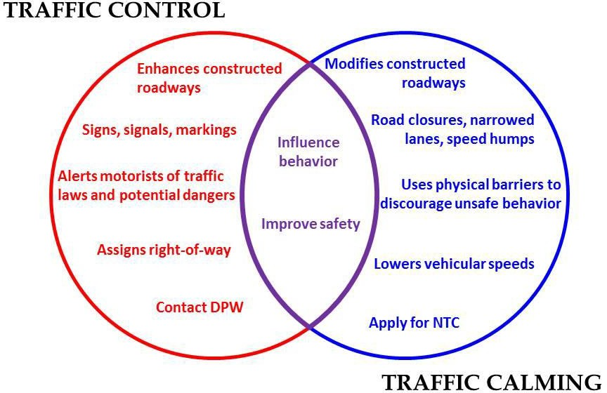
What are the options?
If the main issue is cut-through traffic, we need to alter HOW people move through the neighborhood
If we do it well, we can also see a reduction in speeds

Slide 15
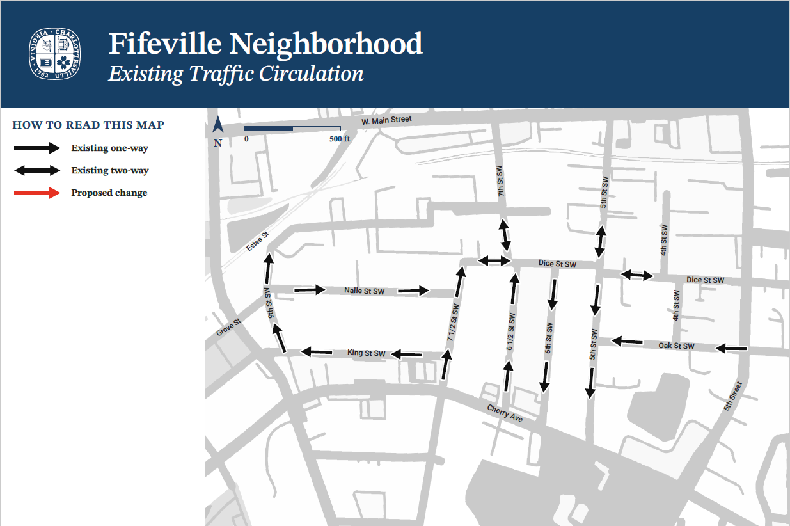

Slide 16
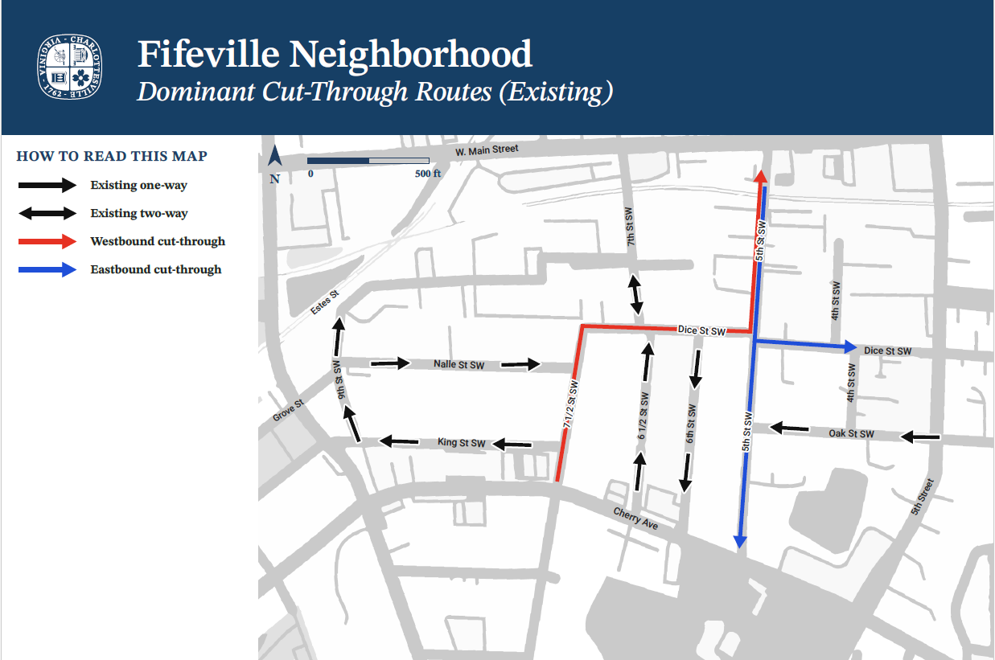

Slide 17
Activity (20 MIN):
FIND A TABLE WITH A MAP
ELECT A NOTE-TAKER/SPOKESPERSON FOR YOUR TABLE
INDICATE ON THE MAP WHERE YOU WOULD LIKE THE FOLLOWING:
  ALTERNATE PARKING TO SLOW VEHICLES
  CHANGE THE DIRECTION OF STREETS TO REDUCE CUT THROUGH TRAFFIC
  STOP CONTROL

Slide 18
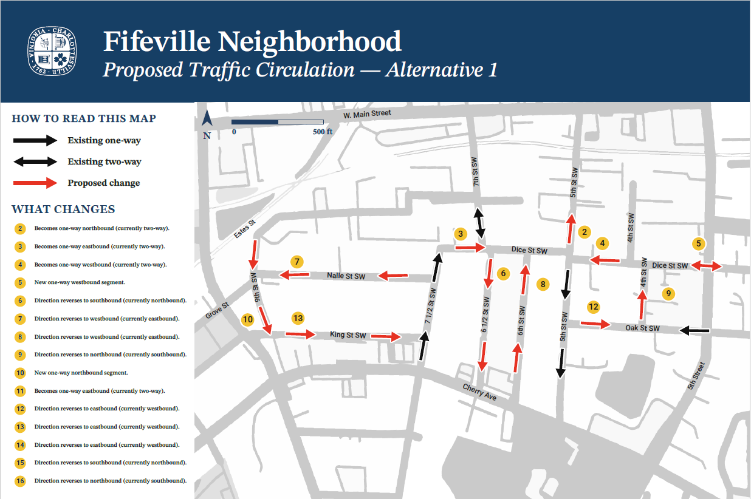

Slide 19
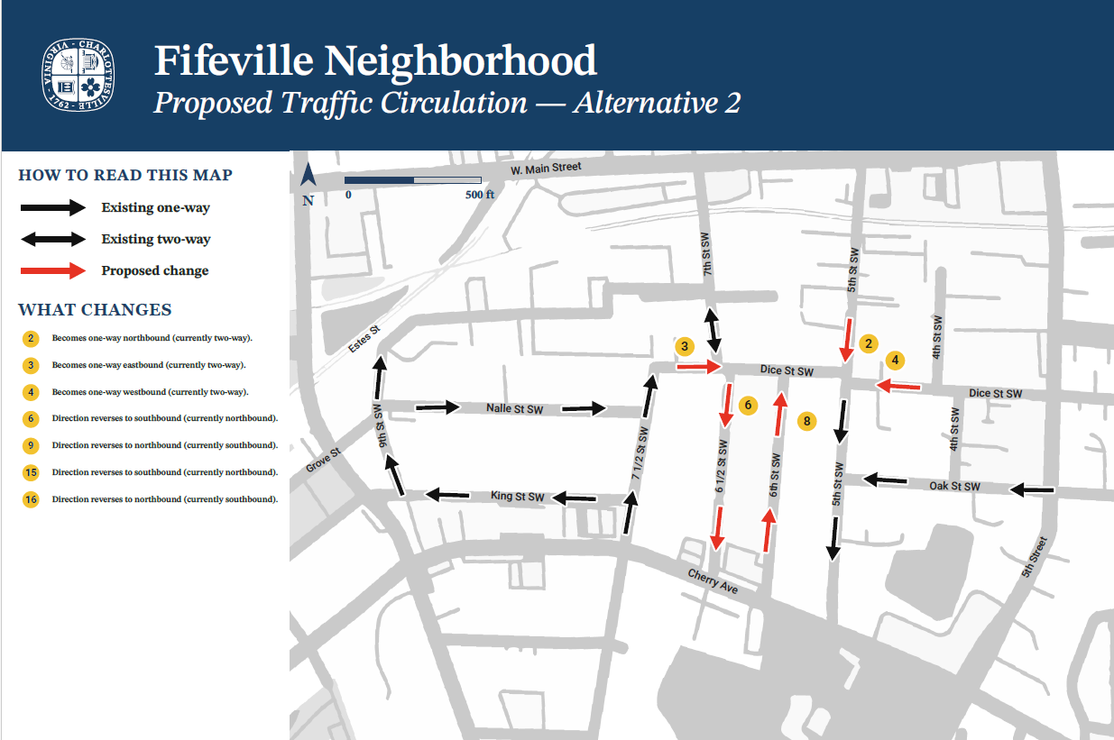

Slide 20
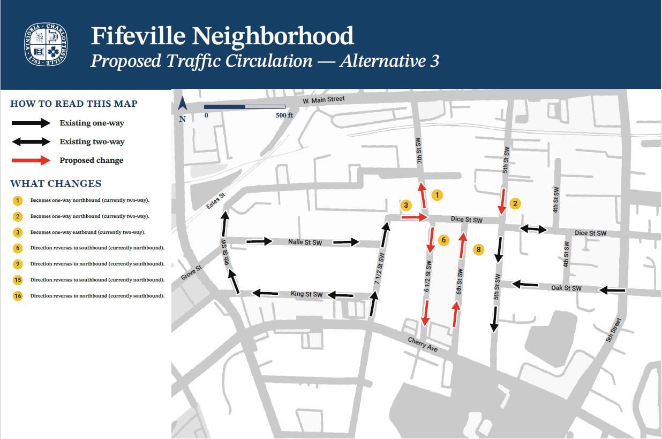

Slide 21
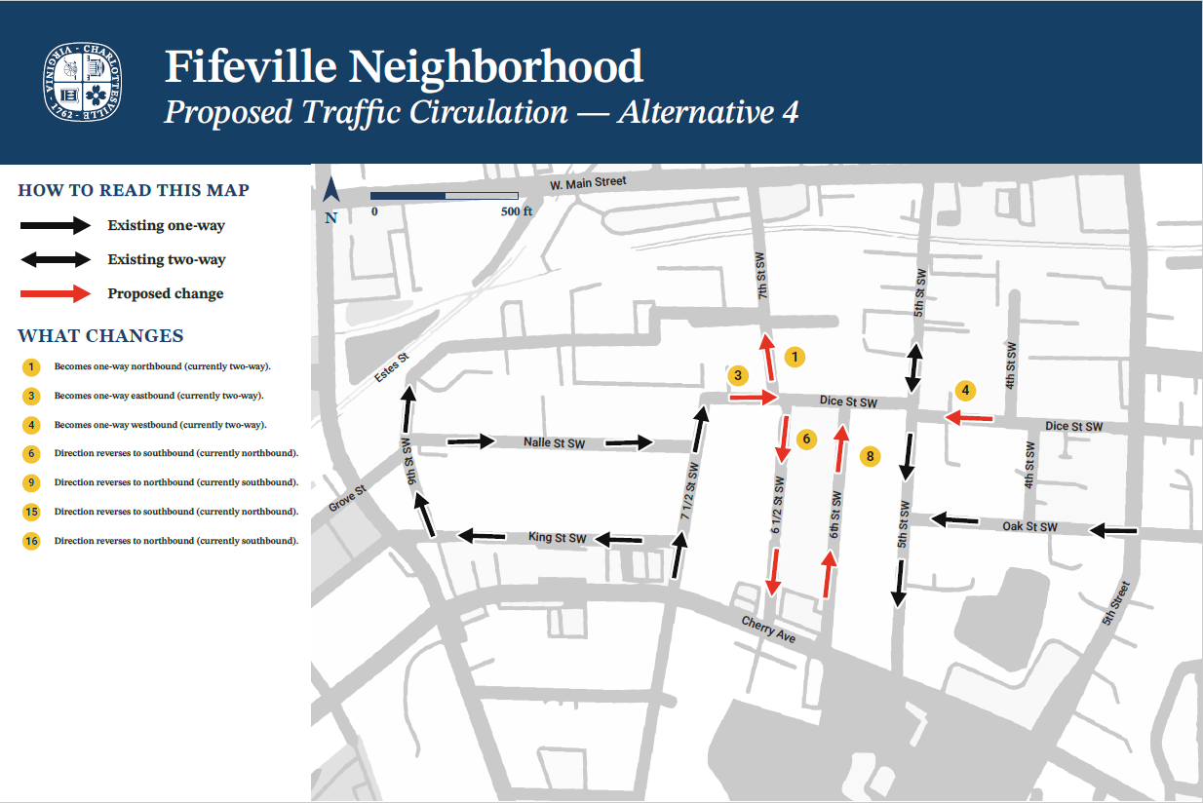

Slide 22
NEXT STEPS:
TAKE IN ALL THE COMMENTS
PREPARE A REVISED IMPLIMENTATION STRATEGY
COME BACK TO THE COMMUNITY TO PRESENT

Slide 23
THANKS
Time
Presence
Attention
Cooperation
Participation
Contributions

